Slide 1
Confidentiality
By reviewing this presentation or participating in a SRC event, you are agreeing not to use the presented information for purposes unrelated to the event until approved by SRC;
Material may be presented that represents current research, some of which has not been published or protected. This material is not for public disclosure and until potential IP rights have been protected, please treat all of the information presented as confidential information which is the property of the researcher and their university.

Slide 2
PASS: Physically-aware Secure Software Execution
Annual Review
Dr. Mark Tehranipoor (PI) and Dr. Farimah Farahmandi (Co-PI) {tehranipoor, farimah} @ece.ufl.edu ECE Dept, University of Florida Date : June 26, 2025

Slide 3








Introduction
Task Leader (PI)
Co-PI
Student
Dr. Mark Tehranipoor Chair at ECE Dept.
Dr. Farimah Farahmandi
Assistant Professor at ECE Dept.
Mridha Md Mashahedur Rahman
Expected Grad. (Ph.D.): May 2026
Industry Liaisons
Maitreyi Ashok
Yi-yen Hsieh
Sohrab Aftabjahani
Amitabh Das
Nitin Pundir

Slide 4
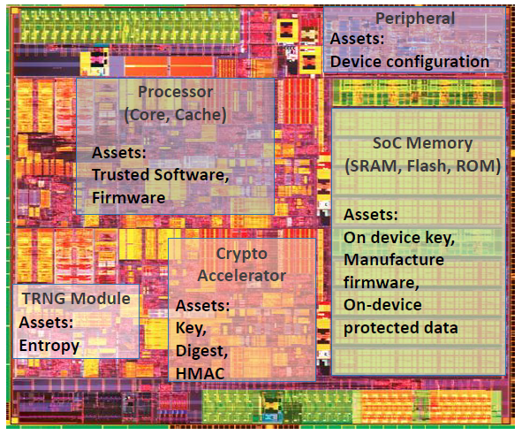
Motivation
Need to protect security assets from Physical Attacks
Most components of modern SoCs store some security asset like On-device keys, Manufacturer firmware, etc.
Software running on vulnerable hardware is not secure
Software execution is susceptible to both software and hardware attacks
Physical Attack targets the physical logic implementations, bypassing upper-level security measures
Software developers/compilers are not informed of physical attacks (like Fault Injection Attacks)
The only existing physical modeling in compilers is based on unrealistic software-based predictions [1]
The various security assets in a modern Intel SoC that needs to be protected. Source: Intel
Notes:
Modern SoCs are made of different components which house a variety of security assets and sensitive data which need to be protected from unauthorized access.
These assets are targets of a myriad of cyber attacks including hardware attacks.
Existing efforts have tried to predict it using observable characteristics from the upper level. Most physical characteristics are not observable from the upper level because of abstraction and thus these upper-level predictions are unrealistic and ineffective.

Slide 5
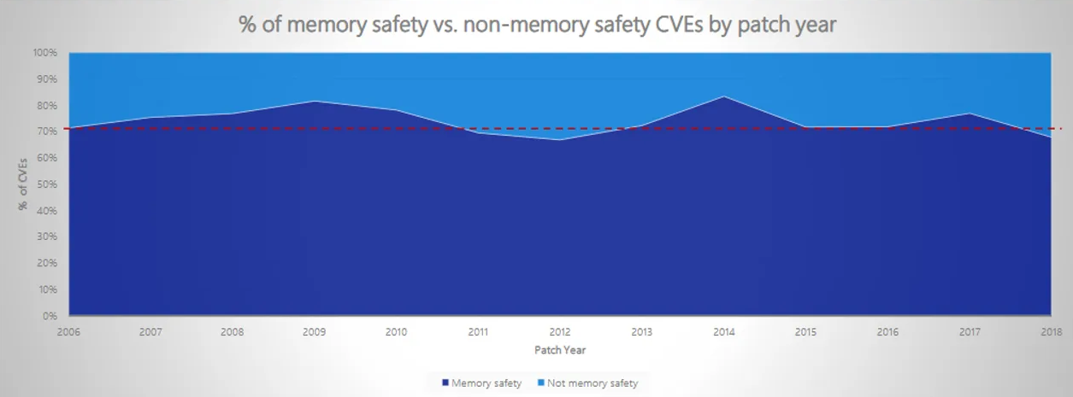
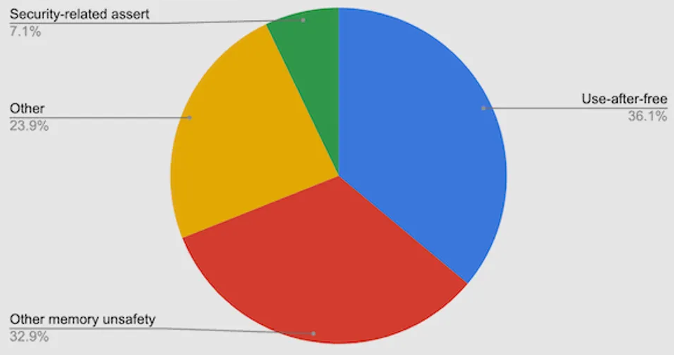
Background
Vulnerabilities
C/C++ codes are susceptible to memory safety and control flow violations
Compiler Hardening
Existing compiler hardening techniques address software level vulnerabilities by setting security flags in compiler [1],[9]
They fail to address physical attack vulnerabilities because much of physical attributes are abstracted at software level [10]
Our solution :
Adding physical hardening measures to compiler so compiled code is physically-aware of underlying vulnerabilities
Microsoft says around 70% of security updates address memory safety vulnerabilities in their products [8]
Google says upto 70% of security issues in Google Chrome are related to memory safety. [8]
Notes:
Memory safety related vulnerabilities form the bulk of security issues in popular softwares. The standard compilers can harden against software level vulnerabilities but cannot address physical level vulnerabilities. Integrating physical attack hardening to compiler enables code to be compiled in physically aware fashion. So physical attack vulnerabilities discovered post silicon can be addressed without expensive call-outs and rollbacks.

Slide 6
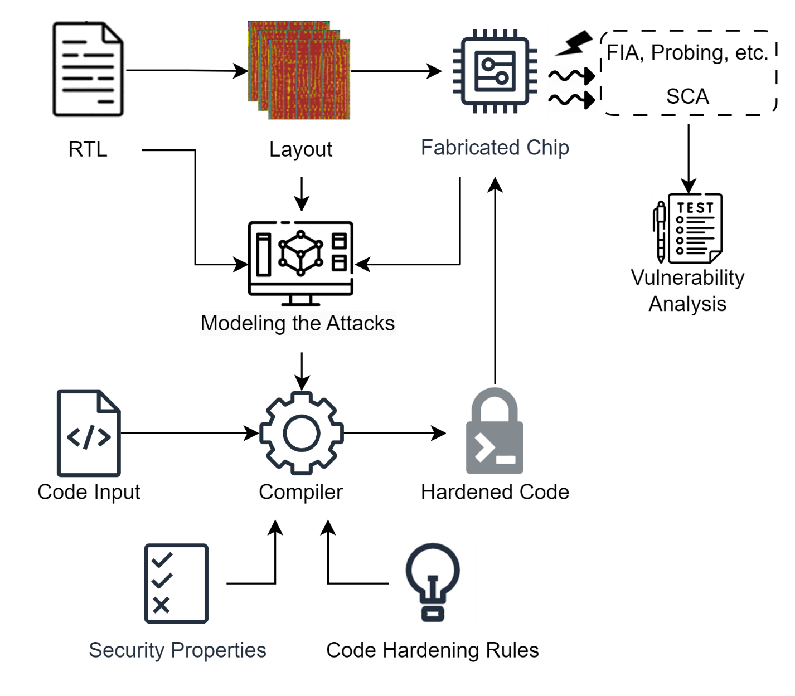
Proposed Workflow – Physical Hardening at Compilation
Highlights of our proposed workflow
Fast and Powerful : Addressing physical threats during code compilation is fast and powerful because compiler links the hardware and software.
Scalable and Cost effective : When physical vulnerabilities are discovered post-silicon stage, their hardening can be added to our framework, saving expensive chip callbacks.
Objectives
Effective physical modeling of Fault Injection Attacks to make the compiler physically-aware
To implement and demonstrate Physical Hardening during compilation against Fault Injection Attacks
Fault-Injection Attacks
Software Hardening against Physical Attacks at Compilation
Notes:
Our work aims to develop a hardened compiler that can take a high level non hardened code and compile it into physically hardened machine level code. The compilation stage is perfect for implementing this hardening bc the software is linked to underlying hardware during this stage.
First major step is physical modelling of the attacks. So we take the layout level information of a fabricated chip and simulate physical attacks on it.
Once we have modeled the attack we implement security properties and corresponding hardening techniques. These hardening techniques are applied during compilation, so we get a physically hardened machine code.
Lastly, its important we evaluate our hardening by running the hardened code on the same chip and analyzing how much improvement we are seeing and in which areas.

Slide 7
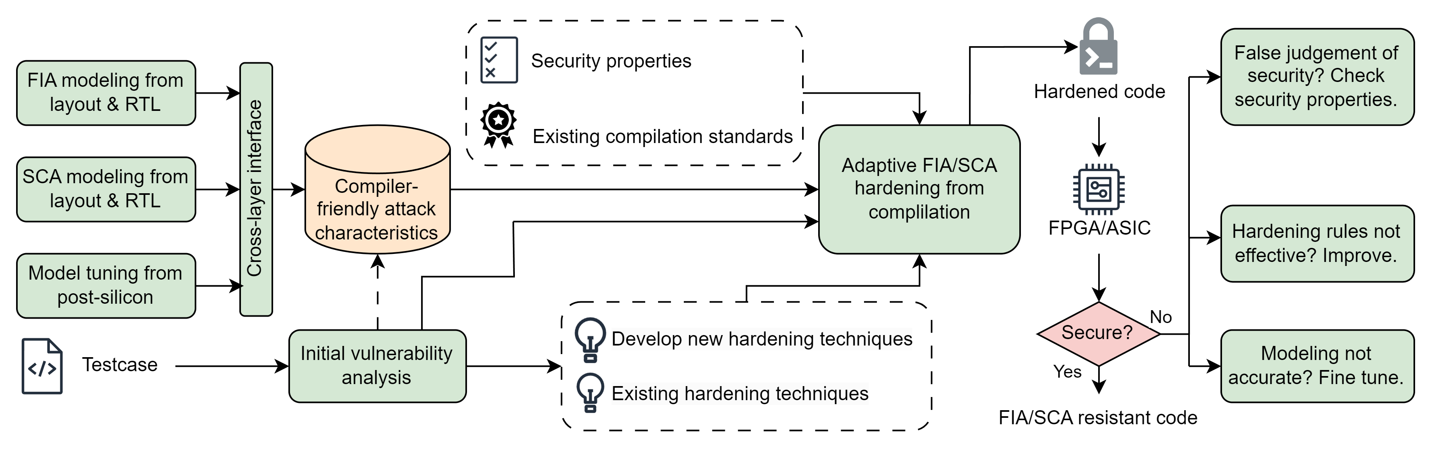
Project Tasks and Timeline
Task 1: Attack Modeling
Task 2: Compiler Development
Task 3: Evaluation
 | Year 1 |  | Year 2
Task 1: Attack Modeling
Task 2: Compiler Development
Task 3: Evaluation

Slide 8
Task 1: FIA/SCA Modeling
Technical Approach
Understand the logical impact of FIA/SCA
Understand the physical behavior of FIA/SCA
Through RTL/layout-level/post-silicon simulations and experiments, model the FIA/SCA effects under given input parameters
For FIA, laser/optical fault-injections, clock/voltage glitching, and EM fault-injections have different mechanisms and modeling approaches
Identify the cross-layer effects: how does the physical fault eventually impact the code execution?
Deliverables
Model equations or look-up tables

Slide 9
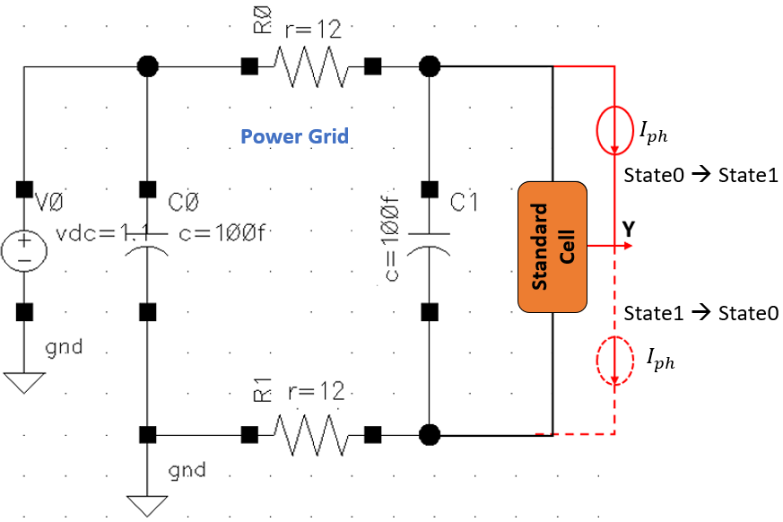

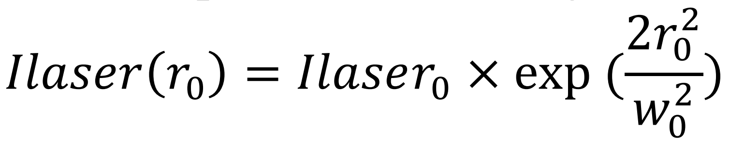
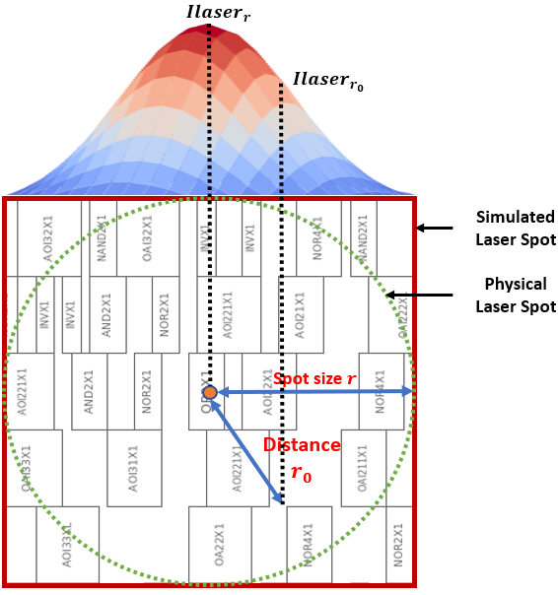
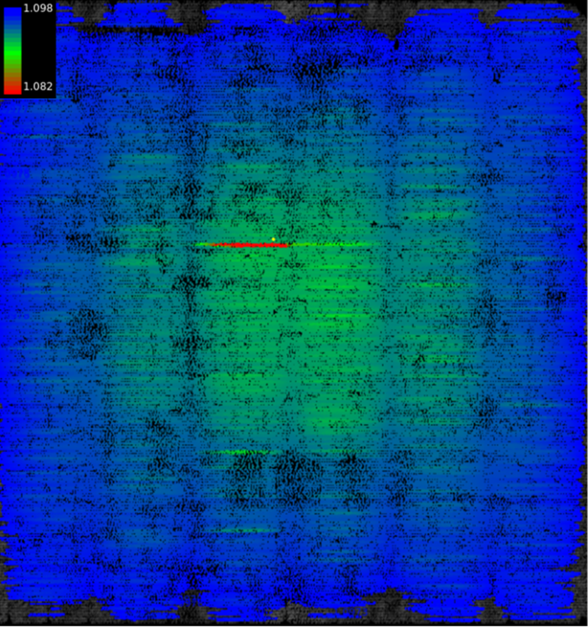
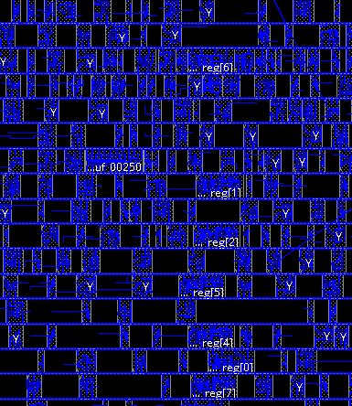
Task 1: FIA/SCA Modeling
Example: laser fault-injection modeling from layout info
Laser effect can be modeled as extra current sources in SPICE simulations, then applied in dynamic IR drop simulations (result: build a connection between laser intensity per cell and cell’s accurate current demand)
Cells’ current demand under laser impact will determine whether the fault can be injected
Example: clock/voltage glitch modeling from layout info
Clock/voltage glitch causes timing violations across the sequential components
Can be modeled as delay changes, i.e., converting fault to time
Repeat for all type of standard cells
Voltage drop simulation on the layout
Substitute impacted cells’ current
response with laser-impacted version

Slide 10
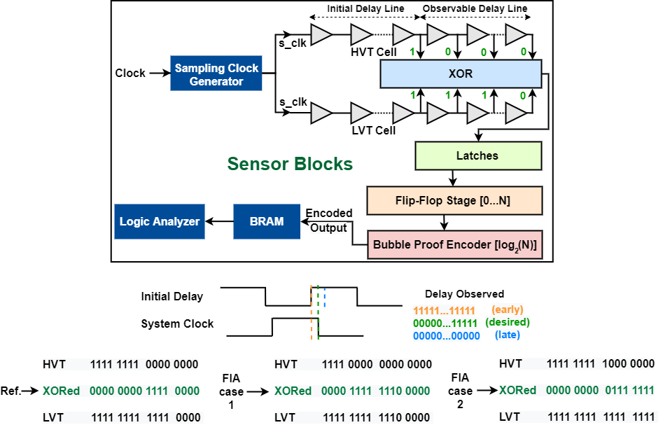
Task 1: FIA/SCA Modeling
Example: laser fault-injection modeling from layout info
Laser effect can be modeled as extra current sources in SPICE simulations, then applied in dynamic IR drop simulations (result: build a connection between laser intensity per cell and cell’s accurate current demand)
Cells’ current demand under laser impact will determine whether the fault can be injected
Example: clock/voltage glitch modeling from layout info
Clock/voltage glitch causes timing violations across the sequential components
Can be modeled as delay changes, i.e., converting fault to time

Slide 11
Task 2 : Compiler Development
Test case
Hardened GCC-RISC Cross compiler - C/C++ -> RV32i Assembly code compilation with added physical hardening implemented by GCC Plugin
Security Properties for Hardening
Vulnerability identified based on Physical Modeling and existing hardening standards were used to create corresponding Security Properties
The Physical Modeling - Compiler Interface
Physical Modeling info needs to be translated to be compiler-friendly
Compiler Interface provides:
Configurable “hardening level” input to determine the input for FIA models (e.g., laser intensities)
Simple mechanism to determine target critical instructions (e.g., directly extract sensitive instructions from security properties; or through static code analysis.)
Translation from target instructions to actual physical instances/area, which serves as final input for models
Compiler Interface receives:
Feedback from physical modeling in a compatible form of either
Threat level / Vulnerability ranking of sensitive instances under analysis, or
Vulnerability Analysis from modeling under certain parameter inputs
Notes:
Compiler takes high level code (C/C++) and compile it into hardened machine code
Compiler hardening level flexible so performance and overhead tradeoff can be configured as needed.
Physical Modeling information needs to be in a form that is actionable at compilation stage.

Slide 12
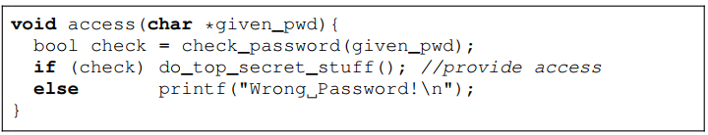
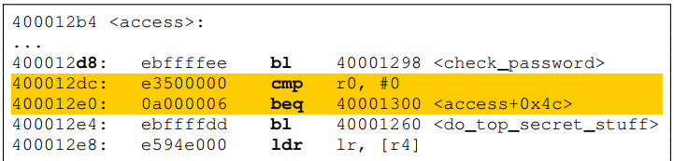
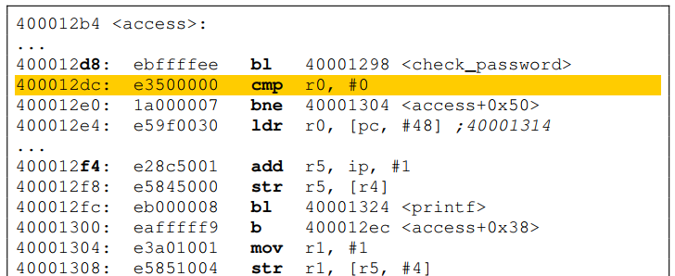
Task 2: Compiler Development
Hardening rules database
Goal: address the physical faults during the compilation process
Review existing hardening approaches
Utilize or imitate existing solutions in RISC-V GNU compiler
Develop adaptive approach to apply countermeasures using the info (e.g., vulnerability ranking) given by modeling output
Deliverables
Encapsulated implementation of hardening compiler
Proper documentations
Compile
Harden
Faults modifying/bypassing the conditional jump will now directly lead to a password-checking failure

Slide 13
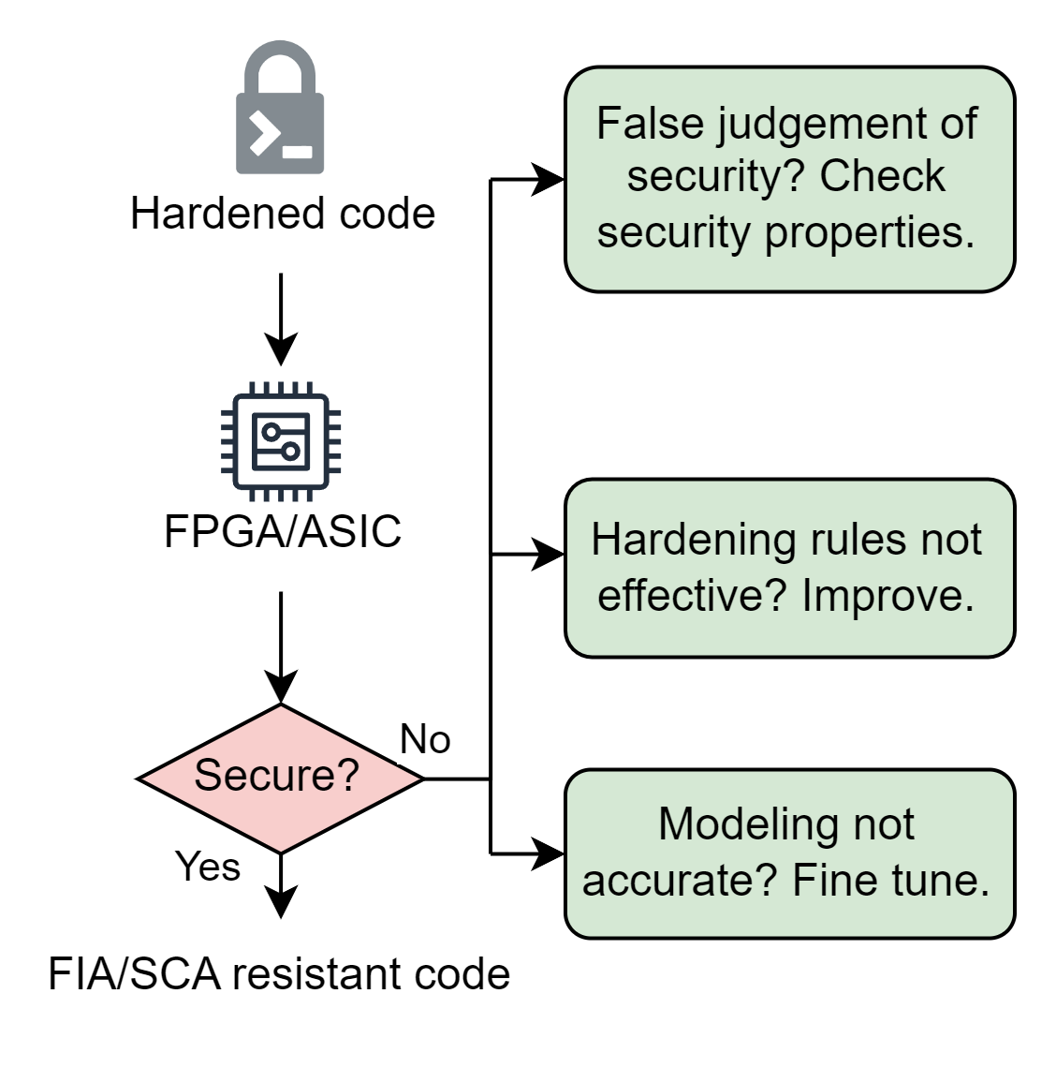
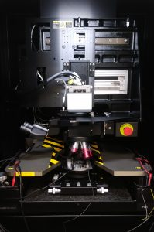

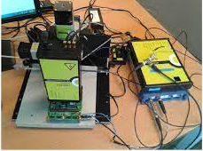
Task 3: Evaluation
Technical Approach
Execute hardened codes on FPGA/ASIC
Perform FIA/SCA vulnerability analysis
Evaluate the hardened code’s resistance, root-cause any issues, automate and improve the compilation flow
Deliverables
FIA/SCA resistant code proven from physical modeling-assisted compilation
FICS lab houses state-of-the-art instruments and capabilities to perform cutting-edge research from device-to-system assurance, security, and integrity analysis.

Slide 14
Task 1 : Fault Injection Attack Modelling (In Progress)
Fault Injection Attacks
Voltage Glitch
Clock Glitch
EMFI
Laser
Optical
V Depletion: increases delay in wire
V Spike: setup time violation
Period Decrease: Setup/hold time violation
Inducing Eddy Current
Focused Beam:
Transistor states change due to current flow
Focused Beam:
Transistor states change due to current flow
Fault Injection Attacks Overview
Our work focuses on Laser Fault Injection Attacks which aim to cause a bit-flip at critical locations.
Notes:
To characterize how fault-injection attacks impact hardware at the circuit level, we explore different fault injection attack modalities.
Voltage depletion increases delay in wire, and voltage spike violate setup time.
Clock glitch violates setup/hold time
EMFI introduces Eddy current
Optical and laser-based ones, exploit physical vulnerabilities in hardware by changing the transistor states due to current flow.
In this paper, we focus on Laser Fault Injection which can be physically modeled by the induced current causing the bit flip.

Slide 15
Task 1 : Fault Injection Attack Modelling (In Progress)
An adversary’s objective is to tamper with security-critical locations and violate security properties
Grey box attack model
Require physical access to the target device
Non-invasive or semi-invasive(backside polishing) fault injection
Attacker has access to certain optical/opto-electrical setup-
Laser source, ex: Diode laser
Optical source, ex: Flash gun
Measurement tools, ex: PC, oscilloscope etc.
Threat Model And Assumptions
Notes:
Our attack model is grey box because adversary needs to know security critical locations and this is a fair assumption because attacker can find out physical layout info from physical inspection, etc
It is assumed attacker has necessary tools and resources to inject the fault.

Slide 16
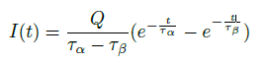
Task 1 : Fault Injection Attack Modelling (In Progress)
Physical modeling of Laser Fault Injection
Physical impact of laser can be modeled as extra current sources in SPICE simulations.
The induced current I(t) can be modeled by the following equation [11] where, Q is the number of charges deposited by the particle strike, τ_{α} is a process-dependent collection time constant of the junction, τ_{β} is the constant of the ion-track establishing time.
Cells’ current demand under laser impact determines feasibility of the Fault Injection
The design’s vulnerabilities can be determined and ranked by observing the current demand variations at VDD/VSS pins.
SPICE model simulating Standard Cell under Laser Fault Injection
Repeat for all type of standard cells
Substitute impacted cells’ current
response with laser induced current
Map voltage drop simulations on the physical layout
Physical Modeling Workflow – provides ranked physical vulnerability information to Compiler
Notes:
Here, we characterize the laser fault injection and determine how faults can be introduced, their duration, and their effects. Since laser alters transistor behavior by introducing current, laser faults can be thought of an extra current source between output and VDD (for bit flip 0 to 1); or output and ground (for bit flip 1 to 0)
We model different standard cells with a RF circuit, and observe the delay, and demand current changes for those standard circuit. The fault effect is modeled using a double-exponential current equation, where injected charge alters voltage transitions. These models help rank vulnerabilities across different logic cells (e.g., inverters, AND, OR gates) to determine which parts of the hardware are most susceptible.

Slide 17
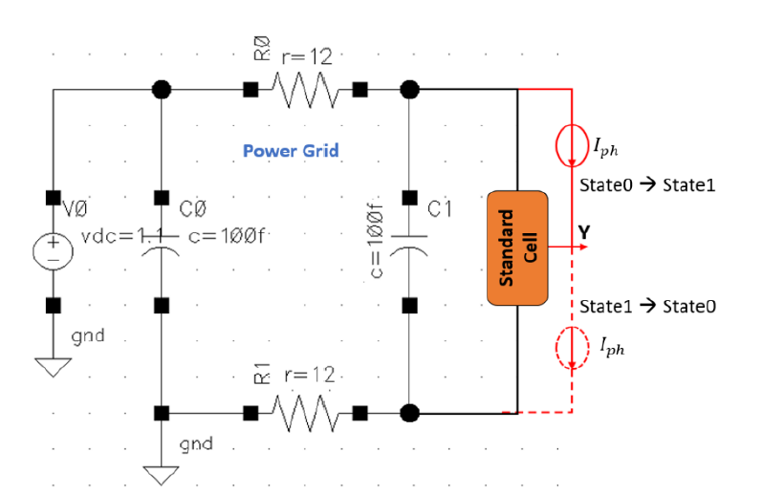
Task 1 : Fault Injection Attack Modelling (In Progress)
Experimental Setup
Design Under Test : RISCV soft core
Fault simulation tool : Synopsys Z01X is used to simulate pre-silicon fault-injection attacks
Hardening techniques developed on top of the RISCV-GCC compiler toolchain in Ubuntu 22.04 LTS
Cadence Spectre is used for SPICE simulations
Cadence 45 nm standard cell library is used for physical modelling of cells
The Laser Fault Injection (LFI) is simulated by the SPICE circuit shown in adjoining figure.
Every standard cell is simulated for LFI when in State0 and State1, and the currents on VDD and VSS rails are captured for both states.
These currents on power rails during laser illumination are recorded for all the standard cells in the library
SPICE model simulating Standard Cell under Laser Fault Injection
Captured current demands across power rails for simulation of Inverter Cell under LFI
Notes:
To simulate the behavior of standard cells under laser illumination, we constructed a SPICE circuit. , as shown. This setup provided a simplified yet effective means of analyzing the impact of laser fault injection on complex standard cells. Every standard cell is simulated for laser illumination when in State0 and State1, and the currents on VDD and VSS rails are captured for both states. These currents on power rails during laser illumination are recorded for all the
standard cells in the library. Fig on right shows the current profiles at the VDD rail for the inverter’s two states (i.e., LFI State0 and LFI State1) when at the center of the 2W laser spot

Slide 18
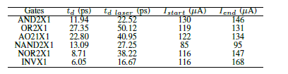
Task 1 : Fault Injection Attack Modelling (In Progress)
Impact of LFI on delay in Standard Cells
In this table, we present two physical characteristics of the standard cells involved in implementation of our test program with sensitive branches:
The delay observed at output for high to low transition with and without laser fault injection,
The laser induced current before and after signal distortion
The table shows that some cells are more vulnerable than others.
Adjoining figure shows that scaling the Laser Intensity also increases the delay since laser induced current slows down voltage transition.
Output delay variations and laser current values
when signal distortions start and end.
Takeaways
Delay and voltage responses on AND2X1 standard cell when scaling the laser-induced current.
Notes:
It is observed that, the delay of critical gates increases significantly under attack.
For example, in case of AND2X1 gate, delay increases from 11.94 ps to 22.52 ps under laser-induced current.
For INVX1 gate, laser-induced faults become significant at 116 µA to 168 µA. These results highlight that certain cells are more vulnerable than others.
How this impacts the software compilation process:
The results are fed into the compiler to help determine where fault-hardened code transformations should be applied based on the feasibility and criticality analysis we did before.
This ensures that critical computations are protected without costly hardware redesign.

Slide 19
Task 2 : Compiler Development (In Progress)
Compiler Hardening Example – Branch Hardening
If the branch condition is bypassed/modified by a Fault Injection the attacker gets access to the security asset in the fall-through branch.
We harden this by re-implementing same logic using different instructions such that security asset is not in the fall-through branch.
Similarly other hardening rules can be implemented and added to the compiler, including the existing hardening standards.
Thus, we create a Security Rule Database based on Physical Modeling and Fault Simulations.
Source code in C
Compile with GCC-RISCV
Harden
Assembly code compiled with built-in security flags
Hardened code from our proposed flow
Impact of with hardening :
Faults modifying/bypassing the conditional jump will now directly lead to a password-checking failure
Notes:
An example of a hardening rule –
branch hardening : if my compiled assembly code stores security asset in default branch, branch condition can be easily skipped by a fault injection and attacker will get access to security asset;
this can be hardened by storing the security asset in a branch that requires a jump. So skipping branch condition will not give access to security asset.
Other similar hardening rules to be added to our compiler, in addition to existing hardening rules.

Slide 20
Summary
We proposed a novel hardening flow that allows to address Fault Injection Vulnerabilities at the software compilation stage.
Our approach models Fault-Injection Attacks based on physical design characteristics, facilitating secure software compilations with low-cost and effective physically-aware hardening techniques.
We demonstrated that a critical conditional branch in a password-checking application could be protected against laser fault-injection attacks by reorganizing the assembly instructions during the compilation stage.
Year 1 Deliverable : On track
Addressing problems and updating directions via meetings:
Among PI, Co-PI, and Student
Feedback from Industrial personnel as well (In progress)

Slide 21
Future Work
Improve the precision of our current modeling of Laser Fault Injection
Submit upcoming deliverable for next year
Model other categories of physical attacks such as clock/voltage glitching and side-channel attacks
Extend the hardening database for this physically-aware compiler.
Meeting w/ Industrial liaisons for thorough technical review
Updating research directions based on the feedback

Slide 22
Acknowledgement
Sources of Funding
This project has been made possible by the funding provided by SRC (GRC #3315)
Facilities
This project is also supported by the resources and facilities provided by Florida Institute of Cyber Security at the University of Florida
Key people
We also want to share our deepest gratitude for Dr Mark Tehranipoor and Dr Farimah Farahmandi for their invaluable advice and Dr Rakibul Hassan for his continuous guidance and support every step of the way.
Industry Liaison
We have already reached out or plan to reach out to the following Industry Liaison and want to thank them for their time and effort - Ro Cammarota and Sohrab Aftabjahani (Intel), Doug Gardner and Maitreyi Ashok (Analog Devices), Peilin Song and Nitin Pundir (IBM), Amitabh Das and Dhwani Mehta (AMD), Harry Chen and Yi-yen Hsieh (MediaTek)

Slide 23
References
[1] GCC, the GNU Compiler Collection, “Program instrumentation options,” https://gcc.gnu.org/onlinedocs/gcc/Instrumentation-Options.html [2] N. Moro, A. Dehbaoui, K. Heydemann, B. Robisson, and E. Encrenaz, “Electromagnetic fault injection: Towards a fault model on a 32-bit microcontroller,” in 2013 Workshop on Fault Diagnosis and Tolerance in Cryptography, 2013, pp. 77–88.
[3] T. M. Corporation, “Cve program mission.” [Online]. Available: https://www.cve.org
[4] L. Dureuil, G. Petiot, M.-L. Potet, T.-H. Le, A. Crohen, and P. de Choudens, “FISSC: a fault injection and simulation secure collection,” in SAFECOMP 2016 - The 35th International conference on Computer Safety, Reliability and Security, vol. 9922, 2016, pp. 3–11.
[5] T. Farheen, S. Tajik, and D. Forte, “Spred: Spatially distributed laser fault injection resilient design,” in 2023 24th International Symposium on Quality Electronic Design (ISQED), 2023, pp. 1–8.
[6] M. Agoyan, J.-M. Dutertre, A.-P. Mirbaha, D. Naccache, A.-L. Ribotta, and A. Tria, “How to flip a bit?” in 2010 IEEE 16th International On-Line Testing Symposium, 2010, pp. 235–239.
[7] J.-M. Schmidt and M. Hutter, Optical and em fault-attacks on crt-based rsa: Concrete results. Proc. Austrian Workshop Microelectron, 2007.
[8] C. Cimpanu, “Chrome: 70% of all security bugs are memory safety issues.” [Online]. Available: https://www.zdnet.com/article/chrome-70-of-all-security-bugs-are-memory-safety-issues/
[9] J. Laurent, V. Beroulle, C. Deleuze, F. Pebay-Peyroula, and A. Papadimitriou, “Cross-layer analysis of software fault models and countermeasures against hardware fault attacks in a risc-v processor,” Microprocessors and Microsystems, vol. 71, p. 102862, 2019.
[10] A. Gangolli, Q. H. Mahmoud, and A. Azim, “A systematic review of fault injection attacks on iot systems,” Electronics, vol. 11, no. 13, 2022. [Online]. Available: https://www.mdpi.com/2079-9292/11/13/2023
[11] F. Lu, G. D. Natale, M.-L. Flottes, B. Rouzeyre, and G. Hubert, “Layout aware laser fault injection simulation and modeling: From physical level to gate level,” in 2014 9th IEEE International Conference on Design Technology of Integrated Systems in Nanoscale Era, 2014, pp. 1–6.

Slide 24
Questions?
Mridha Md Mashahedur Rahman (mrahman1@ufl.edu)
Dr. Farimah Farahmandi (farimah@ece.ufl.edu)
Dr. Mark Tehranipoor (tehranipoor@ece.ufl.edu)

